Slide 1
Need Finding
Presented by John Paul C. Villanueva and Raymond Anthony A. Villaflores II

Slide 2
INtroduction
Manila has always had traffic issues, let alone very difficult to travel, especially commuting
EDSA, one of the busiest streets or avenue in Philippines, needs to be addressed
Commuting is a hassle when there are no available seats or the transportation is full

Slide 3
Statement of the problem
Revisited:
Stated that commuters arriving early on the bus stop tend to wait long for the bus to arrive, only to have a longer queue.
Present:
Commuters tend to wait on the bus stop, either early or late, due to crowding and no available spot on the bus (standing or seating).
Commuters overcrowd on bus stops, making it difficult to ride.

Slide 4
user needs
Revisited:
Commuters need an available bus ready at the bus stop
Commuters need a spot on the bus, but a seat is much advisable
Commuters need to know when the bus will arrive
Present:
Commuters need to have a sure seat on the bus, to travel in comfort
Commuters need to know if the bus will have an available seat or it is standing.
Commuters need to know when the bus will arrive and when it will leave.

Slide 5
Point of view
Revisited:
Time eats away as we wait for the bus, better go and do something else while waiting.
Arriving on a bus stop as the bus waits leads to comfortable ride.
Early to arrive takes away time, but arriving on time makes good use of time.
Present:
Availability is necessary
Standing gets you going, but Free-seating is relaxing

Slide 6
Development Plan

Slide 7
Proposed prototype

Slide 8
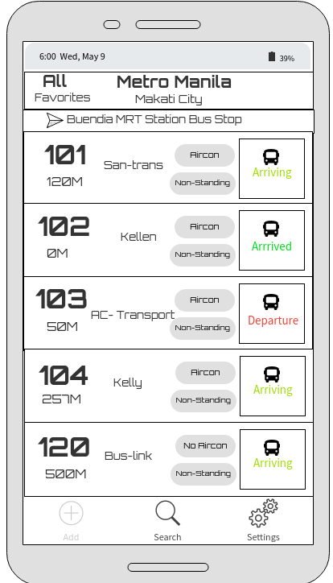
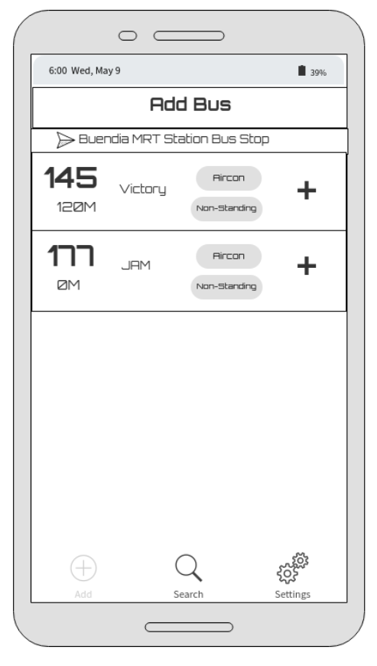
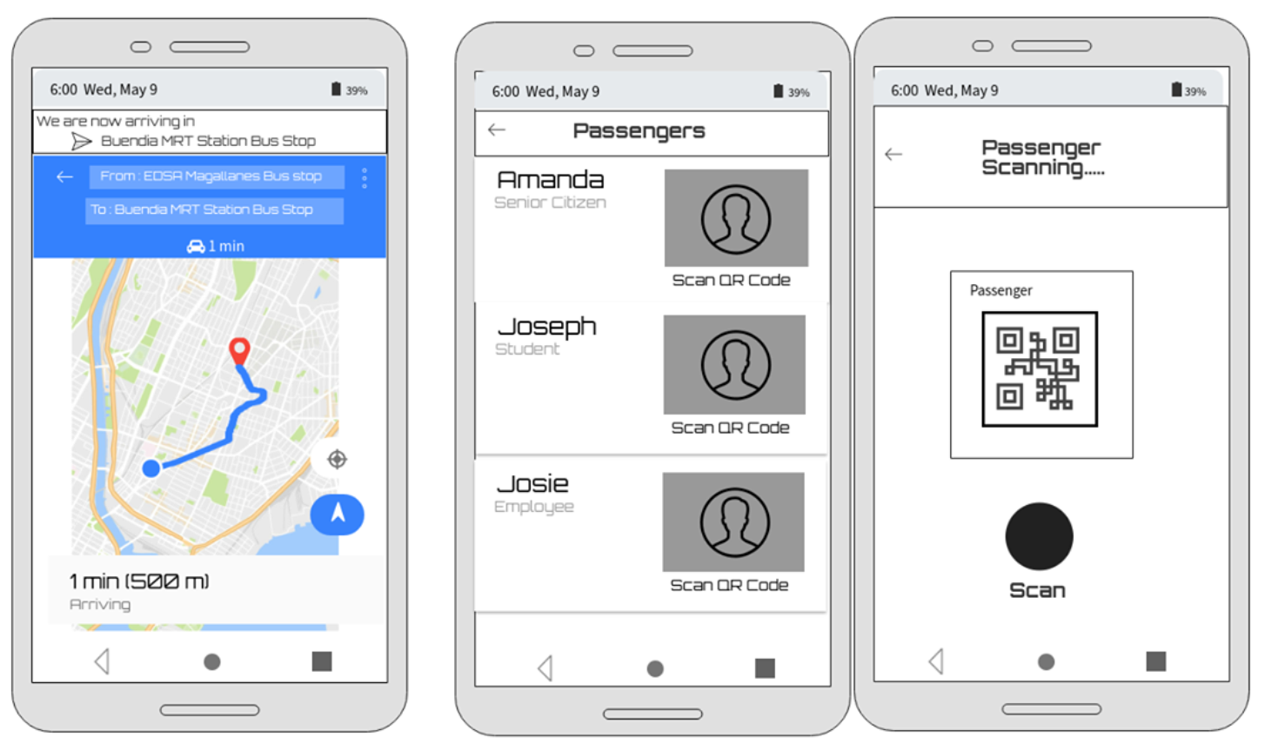
WireFrame
Commuter Interface

Slide 9
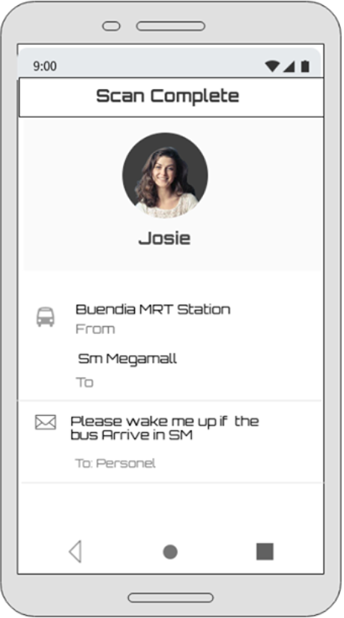
Wireframe
Driver or Conductor Interface

Slide 10
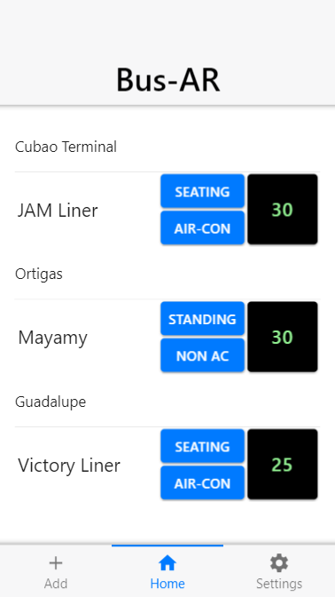
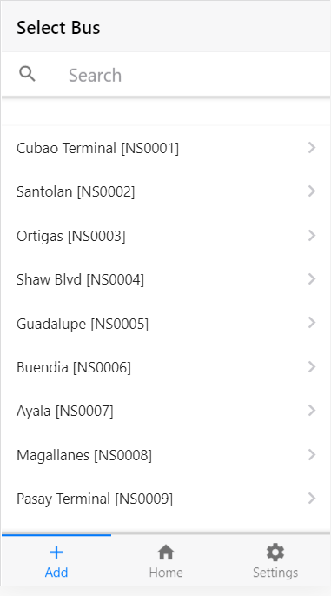
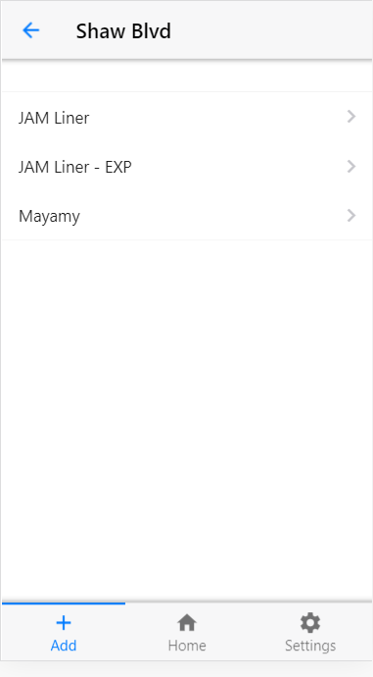
Screens

Slide 11
Prototype Demo
https://www.youtube.com/watch?v=BJvyR2p2RLA – Digital Prototype https://www.youtube.com/watch?v=-qyz5-8RMlc – Paper Prototype

Slide 12
Suggestion & FEEDBACK
Suggestions:
Pop-up Nearby Bus Stop Suggestion
Vacant Bus Suggestion
Live Track of Bus Time
Know which Bus Reserved
GPS Tracker
Feedback:
Convenient for Commuters
Overcrowding

